Slide 1
PC613: Communication Skills
Sem I, MSc IT
Instructor: Dr. Jenson Joseph

Slide 2
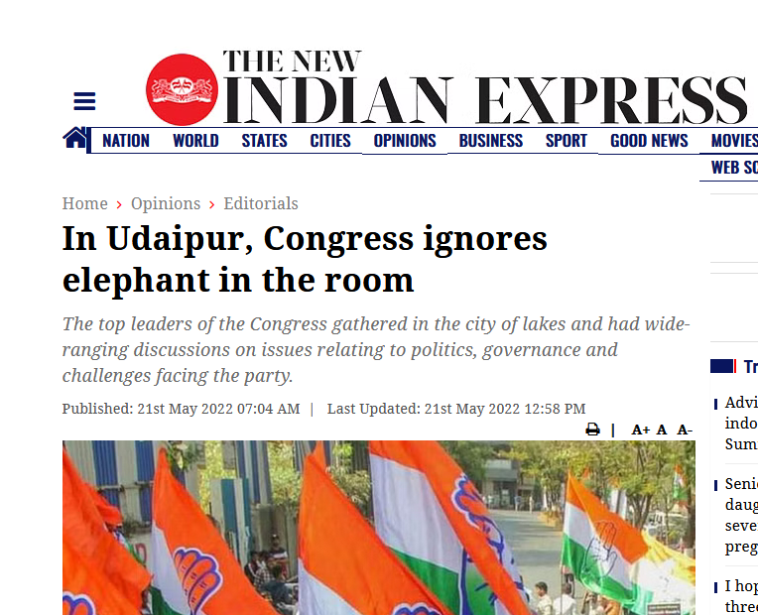
Learn an idiom
“an elephant in the room”

Slide 3
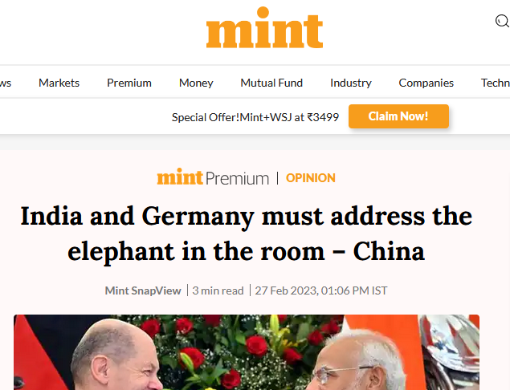
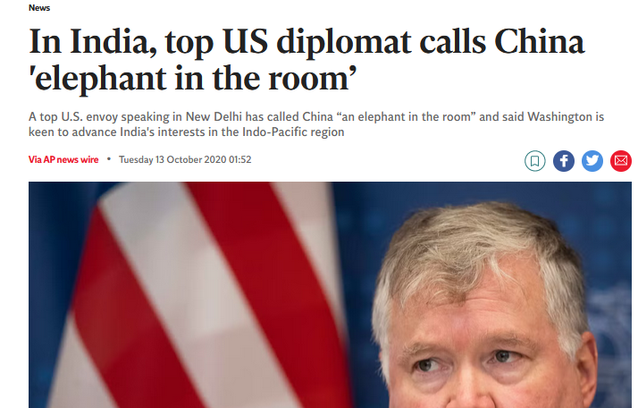
Learn an idiom
“an elephant in the room”

Slide 4
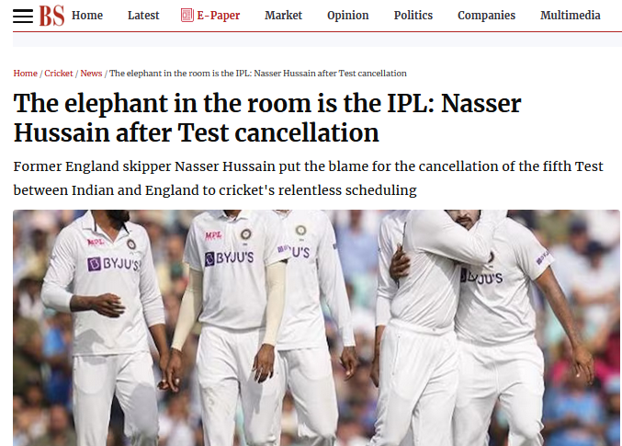
Learn an idiom
“an elephant in the room”

Slide 5
Learn an idiom
If you say, there is “an elephant in the room” you mean that there is an obvious problem or difficult situation that people do not want to talk about.
-- An elephant in the room is an obvious problem that no one wants to discuss;
-- an obvious major problem or issue that people avoid discussing or acknowledging.
Examples:
The elephant in the room in all this is the role of the government.
The elephant in the room no one wanted to see was money.
The truth then becomes the elephant in the room; no matter how obvious it is, the people most affected pretend to others and to themselves that it is not so.
We both know that we can't carry on like this – it's the elephant in the room.

Slide 6
Exercises
At the end or in the end?
-- the end of the film, everyone was crying.
I looked everywhere in the house for the book but couldn’t find it, so -- the end, I bought a new copy.
We worked hard, and -- the end, we achieved our goal.
--- the end of his life, he had no regrets.
--- the end, what really matters in a friendship is trust.
Put a period -- the end of every sentence.
I pay the phone bill -- the end of each month.
-- the end of the game, we were very close to winning. -- the end, our team won.
The bikers reached the destination --- the end. They celebrated --- the end of the journey.

Slide 7
Exercises
At the end or in the end?
Use at the end (often with of) to talk about the point in time where something finishes.
Use in the end to talk about things that happen after a long time or after a series of other events (means "finally," "after a long time," or, "when everything is considered”, “ultimately”).
Examples:
At the end of the film, everyone was crying. (Not, in the end of the film…)
I looked everywhere in the house for the book but couldn’t find it, so in the end I bought a new copy.

Slide 8
Exercises
At the beginning or in the beginning?
-- the beginning of every lesson, the teacher introduced a new idiom to the students.
-- the beginning, nobody understood what was happening, but after she explained everything very carefully, things were much clearer.
--- the beginning, the students were attentive and more disciplined. Students are usually tame --- the beginning of the first year.
--- the beginning of the movie, I had a hard time concentrating.
--- the beginning of the relationship, I had a good time with him.
--- the beginning of the year, I made many promises to myself – and I broke them all!
I’m going to have to look into this -- the beginning of next week.
--- the beginning, the course looked exciting.

Slide 9
Exercises
At the beginning or in the beginning?
Use at the beginning (often with of) to talk about the point where something starts.
Use in the beginning when we contrast two situations in time. Often means, “at first…”
Examples:
At the beginning of every lesson, the teacher introduced a new idiom to the students.
In the beginning, nobody understood what was happening, but after she explained everything very carefully, things were much clearer.
--- the beginning of the story, we learn that the hero has not yet discovered that he has superpowers.

Slide 10
At, in and to (movement)
Uses of ‘to’
We use to when we are talking about movement in the direction of a point, place, or position:
Let’s all go to the cinema tonight!
When you come to my place, you’ll see our new pet rabbit.
If you drive to the end of the road, then turn left and park in the first car park on the right …
When did you go to Barcelona? (Not, when did you go in Mumbai?)
We often use the combination from … to … when we are talking about moving from one point to another:
Is it far from your house to the nearest shop?
How long will it take to get from the hospital to the train station?

Slide 11
At, in and to (movement)
Uses of ‘to’: not with ‘arrive’
We say that we arrive at a place when we see it as point, but we arrive in a larger area (e.g. a city or a country). We don’t use to with arrive:
I arrived at the station just in time.
It was 4 pm when we arrived in Italy.

Slide 12
http://zbenglish.net/sites/voca/AWL/AWLSublist01-Ex1a.htm

Slide 13
Lesson 1: Introducing Oneself
Follow the format given below, but feel free to improvise
Begin with:
Hi everyone
Hello friends
Good morning, everyone/Good morning, all/Good morning, guys
Proceed to: “I am ….; I come from…; my hobbies are…/ I like..; This is the first time I…”
End with pleasantries, like:
I look forward to knowing you all better
Wish you all a great time on campus
Hope you all enjoy your time in DA-IICT

Slide 14
Patel Parth Shankarbhai
Vavdiya Tushar
Kapadia Mansi S
Anmol Rangwani
Sharma Neerav Pradeep
Javiya Shivam J
S Nakshi Upvanbhai
S Siddharthkumar Kanjibhai
Kanchan Kharkwal
Aayushi Sanjay Jindal
Aarni Nigam Raval
Ankita Kumari
Nirali Pradipkumar
Shah Ashvi Sandipkumar
Sunny Saurabh Pandey
Shah Jinansh Jigneshkumar
Luhar Hartik
Vaishnavi Dubey
Bhuva Pratixa
Ankit Kaklotar N
Thadani Vishal
Khushi Trivedi
R Jeevan Bhawarlal
R Rajdeep Singh
Nasikkar H Jitendrabhai
Solanki Hiten Nagajanbhai

Slide 15
https://www.youtube.com/watch?v=mPi1W7DyUl8

